Slide 1

Supply Chain Optimisation and Predictive Model for Store FIT Ltd
Notes:
This project is focused on the supply chain optimisation and predictive model for Store Fit Ltd by Group B Team Members.

Slide 2
Group B Project Team Members
Team Roles and Responsibilities
Business Analyst: Analyzes business processes, identifies improvement areas, and ensures project aligns with business needs.
Imaobong Enoh
Hope Usen
Olaronke Jaiyeola
Victoria Madamidola
Data Analyst: Gathers and processes data and performs preliminary analysis
Frank Egede
Afolake Ajala
Data Scientist: Develops predictive models and performs advanced data analysis
Isaac Olumuyiwa
Notes:
This is group B project, and they are 7 group members comprising of 4 BA’s, 2 DA’s and 1 DS.

Slide 3
Overview of the Presentation
Key Components
The Business Overview: A summary of the business operations of Store Fit Limited.
The objectives of the project.
Supply Chain Dashboard: Development of a robust dashboard to provide real-time monitoring and visualization of supply chain performance.
Predictive Model Analysis: This involves using sophisticated models to predict product purchase patterns and determine optimal safety stock levels.
Safety Stock Evaluation: A thorough assessment of current safety stock levels to identify inefficiencies and recommend adjustments.
Sales Data Analysis: Analysing historical sales data to uncover purchase patterns and seasonal trends.
Findings and Recommendation
Conclusion
Purpose: The primary purpose of this presentation is to provide a comprehensive overview of the supply chain optimization project undertaken for StoreFIT Limited, a fast-growing retail chain with a focus on maximizing customer satisfaction.
Significance: The significance of this project lies in its potential to address critical operational challenges that StoreFIT is currently facing particularly related to inventory management and customer satisfaction.
Aim: By optimizing the supply chain, the project aims to enhance the company's ability to meet customer demand promptly, reduce backorders, and streamline its operations for improved efficiency.
Notes:
This overview details the Purpose, Aim, Significance of the project, as well as the key components of this presentation.
The Purpose is to provide a comprehensive overview of the supply chain operations of Store FIT ltd.
The Aim is to enable the company meet customer demand and enhance operational efficiency.
The significance is to address operational challenges such as inventory management and customer satisfaction.
And the Key Components of this presentation includes the business overview, the objectives, the supply chain dashboard, predictive model analysis, safety stock evaluation, sales data analysis, findings, recommendation and the conclusion.

Slide 4
Introduction
Store FIT Limited, a rapidly growing retail chain, is facing challenges with backorders and customer dissatisfaction due to delays in product availability. To address these issues and maintain their commitment to maximum customer satisfaction, Store FIT has engaged the project Group B Delegates of Pairview Solutions Limited to develop and implement data-driven solutions.
Notes:
Store Fit is a retail company with 25 retail outlets and 227 product lines. They are currently experiencing increasing backorders and have engaged the services of Group B delegates to address these issues.

Slide 5
Objectives of the Project
Develop a strategy to predict product purchase and safety stock level rules.
Develop a robust supply chain dashboard to monitor performance.
Evaluate and optimize safety stock levels.
Identify and address bottlenecks in the supply chain process.
Analyse sales data to identify purchase patterns and optimize inventory management.
Develop an ERP system to integrate Purchase Order, Manufacturing Order, Sales Order, CRM, and website functionalities.
Notes:
The objectives of the project are:
To predict product purchase and determine the safety stock level.
To develop a comprehensive supply chain dashboard.
To evaluate and optimise the safety stock levels.
To identify bottlenecks in the supply chain process.
To analyse sales data and identify purchase patterns and optimise inventory management.
To develop an ERP system. (Unfortunately, we can’t build one right now).

Slide 6
Business Overview
Company Background
StoreFIT Limited is a fast-growing retail chain with over 25 retail outlets. Their success can be attributed to their number one goal of always ensuring maximum customer satisfaction. For this reason, they have made several changes in their operations, one of which has been the introduction of a back-ordering process for items which are not available at the time of ordering.
This implies that for every order they receive, when an item is not available, Store Fit will supply the items they currently have in stock and the rest will be back ordered and shipped whenever they become available.
Current Challenges
Increased Backorders: The introduction of a backordering process initially worked well, but recently, they’ve been a noticeable increase in backorders which is causing delays in order fulfilment, leading to customer dissatisfaction.
Customer Dissatisfaction: Extended wait times for backordered items are negatively impacting customer satisfaction.
Inefficient Supply Chain Processes: The current supply chain processes have inefficiencies and bottlenecks that are exacerbating the issue of backorders and delays.
Lack of Real-Time Data Visibility: StoreFIT’s current systems lack comprehensive real-time data visibility, making it challenging to monitor supply chain performance and make informed decisions quickly.
Notes:
StoreFIT Limited operates within the highly competitive retail industry, which demands constant adaptation to changing consumer preferences and market trends. Customer satisfaction is at the core of StoreFIT’s business strategy. The company’s primary goal is to ensure that customers receive their desired products promptly and reliably.
StoreFIT has implemented several initiatives aimed at enhancing the customer experience, such as a flexible backordering process for out-of-stock items and maintaining high standards of customer service across all its outlets. This worked well at first, but of recent, they’re experiencing challenges such as increased backorders, customer dissatisfaction, inefficient supply chain processes and the lack of a real time data visibility to monitor supply chain performance and make informed decisions.

Slide 7
SWOT Analysis for Store FIT Limited
Strengths
Customer-Centric Approach
Opportunities
Improvement in Inventory Management
Proactive Management
Back-Ordering Process
Fast-Growing Retail Chain
Expansion and Diversification
Technology Integration
Enhanced Customer Experience
Weaknesses
Increased Backorders
Threats
Competition
Supply Chain Disruptions
Manual Processes
Extended Wait Times
Lack of Supply Chain Visibility
Economic Uncertainty
Changing Consumer Preferences
Notes:
The SWOT analysis gives the broader understanding of this company.
The Strengths: Customer-Centric Approach: Store Fit’s primary focus on ensuring maximum customer satisfaction sets it apart in the retail industry.
Fast-Growing Retail Chain: With over 25 retail outlets, Store FIT has established a significant presence in the market.
Back-Ordering Process: The implementation of a back-ordering process demonstrates flexibility in managing inventory and meeting customer demands.
Proactive Management: The management's recognition of issues and willingness to seek solutions indicate a proactive approach to addressing challenges.
Threats: Competition: Intense competition in the retail industry may pose a threat to Store Fit’s market share and profitability.
Supply Chain Disruptions: Disruptions in the supply chain, such as delays in deliveries or shortages of products, could impact Store Fit’s ability to fulfil customer orders.
Changing Consumer Preferences: Shifts in consumer preferences and shopping behaviours may require Store FIT to adapt its strategies and offerings to remain competitive.
Economic Uncertainty: Economic downturns or fluctuations in consumer spending could affect Store Fit’s sales and profitability.

Slide 8
Gap Analysis
Current State
Inaccurate Demand Forecasting
Suboptimal Safety Stock Levels
Inefficient Inventory Management
Longer Lead Times
Inefficient ERP System
No Real Time Data Visibility
Manual Processes
Customer Dissatisfaction
Notes:
The current state of the business:
Inaccurate Demand Forecasting: There’s the absence of a predictive model to forecast product demand resulting in stockouts and overstock situations, impacting both inventories holding costs and customer satisfaction.
Suboptimal Safety Stock Levels: Current safety stock levels do not align with actual demand patterns, leading to either excess inventory or frequent stockouts.
Inefficient Inventory Management: Absence of predictive models to accurately forecast demand and determine optimal safety stock levels.
Manual Processes: Many of the supply chain processes are manual or semi-automated, leading to inefficiencies and errors.
Longer Lead Time: There’s longer lead time impacting customer satisfaction.
Inefficient ERP System Integration: There’s the absence of a comprehensive ERP system resulting in fragmented and inefficient management of purchase orders, sales orders, and customer relationship management.
No Real-Time Data Visibility: The current lack of a real-time supply chain dashboard prevents effective monitoring and decision-making.
Customer Dissatisfaction: There’s extended wait times for backordered items and poor visibility into order status contributing to customer dissatisfaction.

Slide 9
Notes:
1. Customer Places Order: The customer selects items and places an order.
2. Order Processing: The order details are manually checked against inventory. If all items are in stock, the order is processed for shipment. If any items are unavailable, a backorder is created.
3. Inventory Check: The inventory is manually updated based on processed orders and backorders. Stock levels are not actively managed based on demand forecasting.
4. Back-Order Management: Back-ordered items are shipped when they become available, which can cause delays. There is no proactive communication to customers regarding backorders.
5. Order and Inventory System: Orders and inventory status are recorded manually.

Slide 10

Future State
Real Time Data Visibility: Enhanced ability to monitor supply chain performance in real-time.
Predictive Analytics: Accurate product demand forecasting.
Optimized Safety Stock Levels: New strategies for maintaining optimal safety stock levels.
Improved Backordering Process: Streamlined process for handling backorders to reduce customer wait times.
ERP System Integration: Introduction of the new ERP system to integrate various functions and improve efficiency.
Improved Customer Satisfaction: Increased customer satisfaction and reduction in wait time for backordered items.
Notes:
Real-Time Monitoring: The enhanced ability to monitor supply chain performance in real-time.
Predictive Analytics: Improved accuracy in predicting product demand.
Optimized Safety Stock Levels: Seeking new strategies for maintaining optimal safety stock levels.
Improved Backordering Process: Streamlined process for handling backorders to reduce customer wait times.
ERP System Integration: Introduction of the new ERP system to integrate various functions and improve efficiency.
Improved Customer Satisfaction: Increased customer satisfaction and reduction in wait times for backordered items.

Slide 11
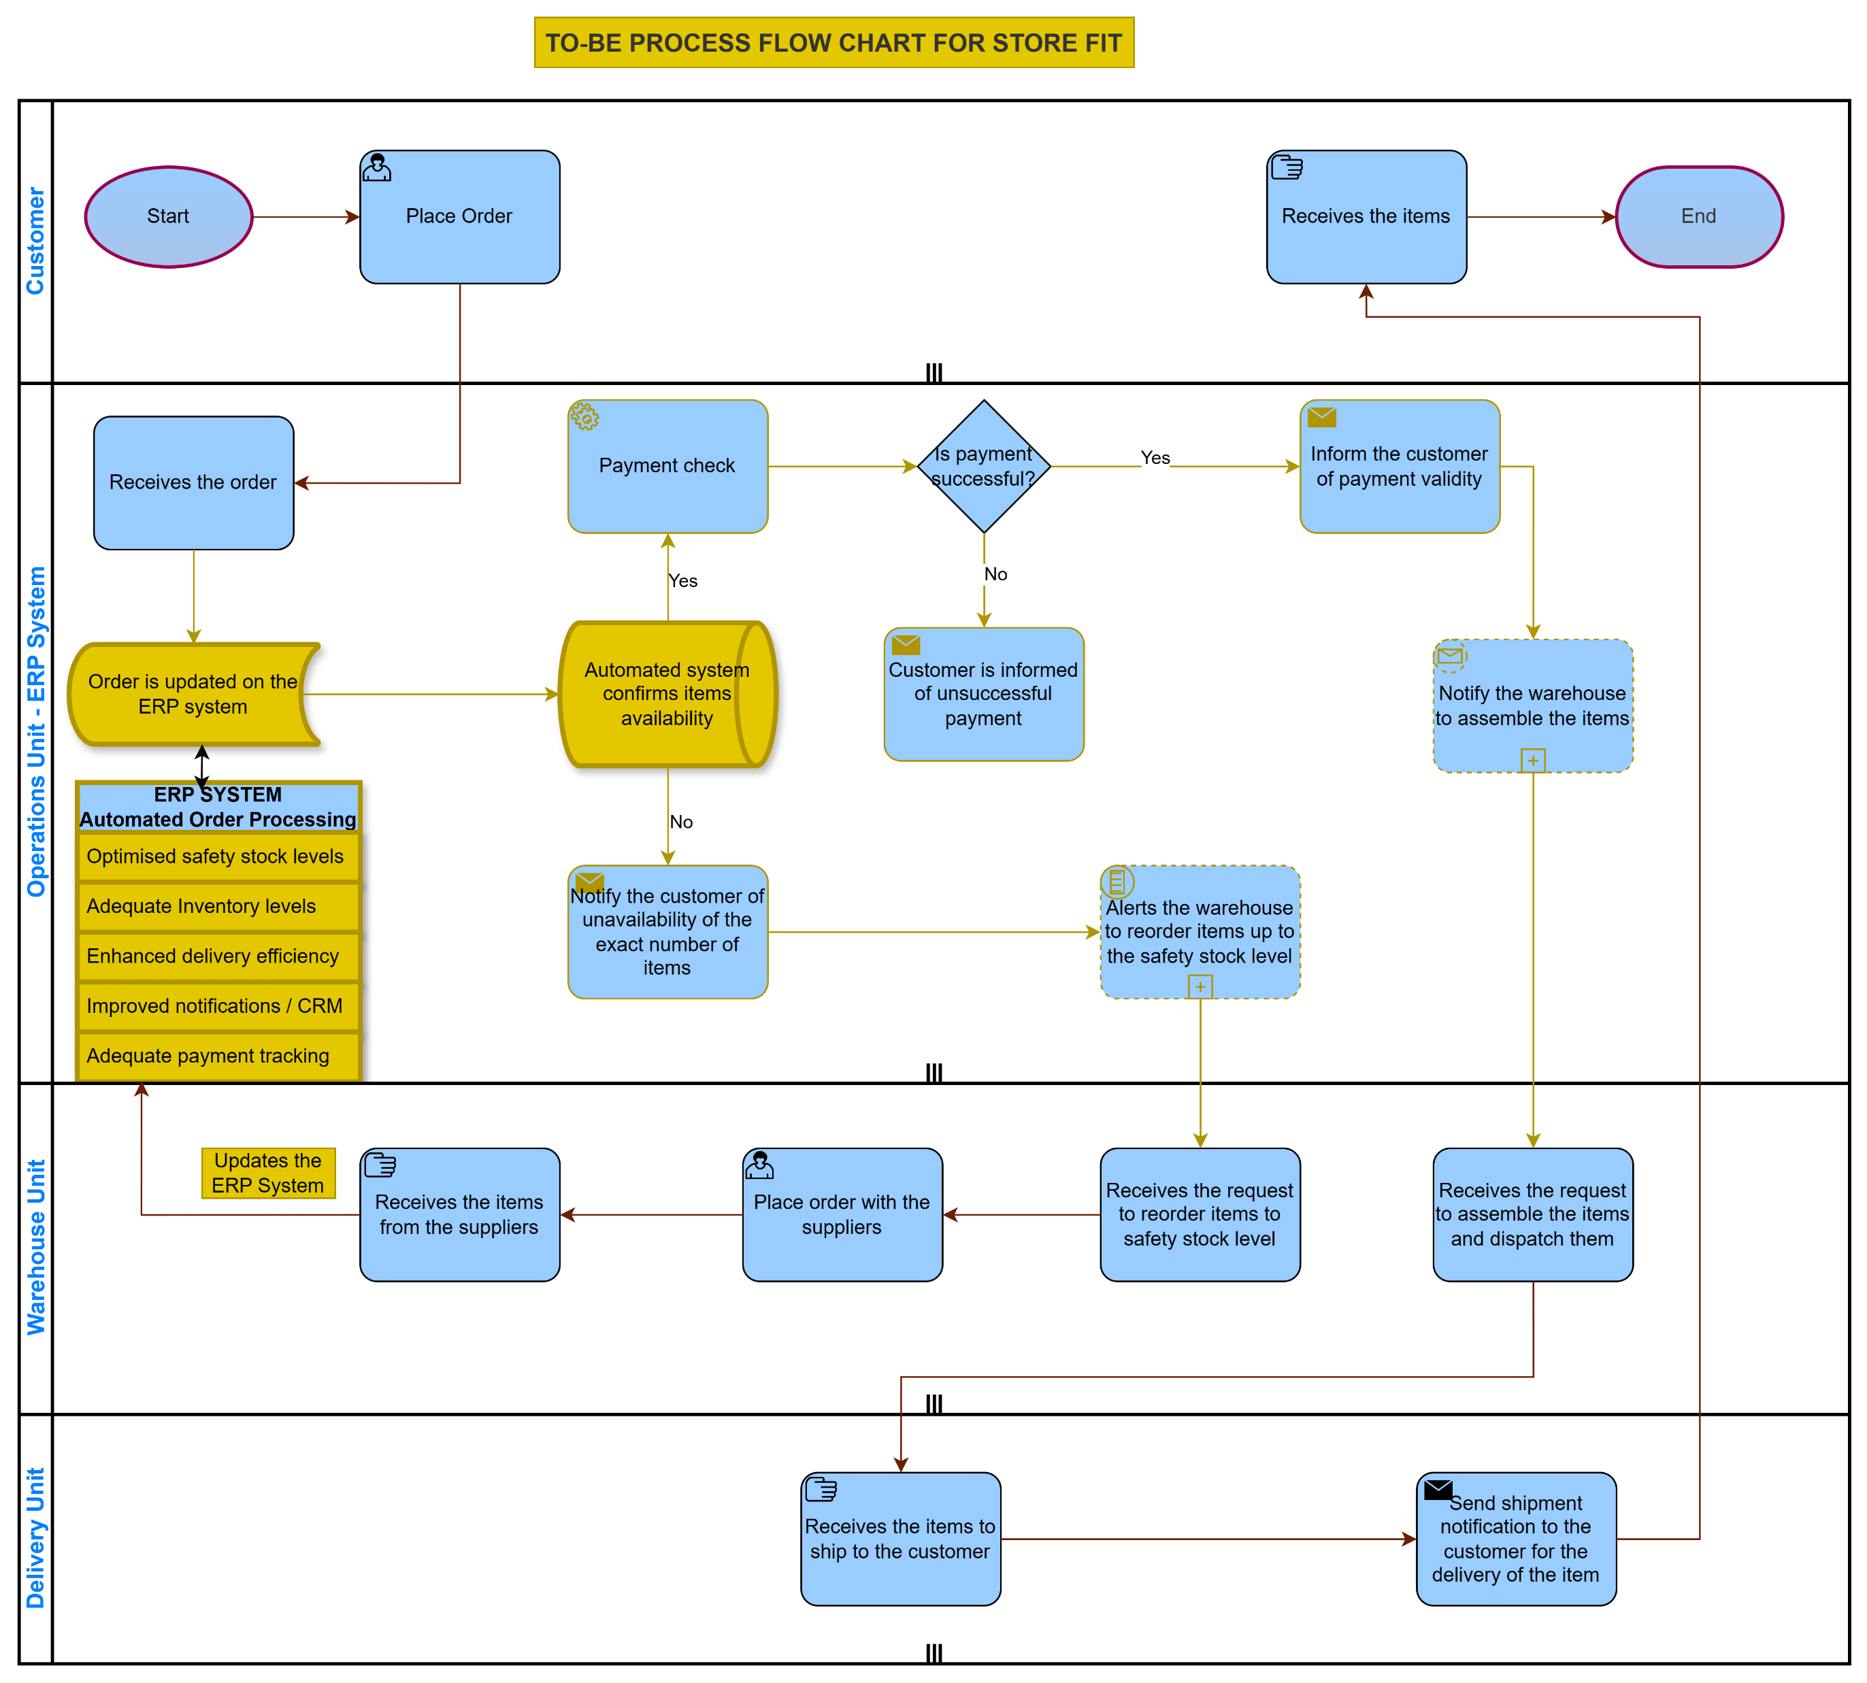
Notes:
1. Customer Order Placement: The customer selects items and places an order.
2. Automated Order Processing: The system automatically verifies order details against the real-time inventory.
If all items are in stock, the order is processed for immediate dispatch.
If any items are unavailable, an alert is initiated for back-order management.
3. Optimized Back-Order Management
A streamlined back-order process with proactive customer communication is in place.
Customers receive notifications about the expected delivery dates for back-ordered items.
4. Integrated ERP System
An integrated ERP system manages Purchase Orders, Manufacturing Orders, Sales Orders, and CRM processes.
It offers real-time order and inventory tracking for enhanced operational efficiency.

Slide 12
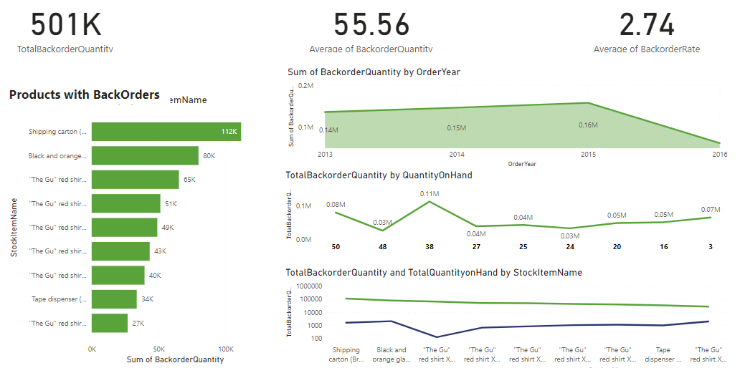
Supply Chain Dashboard for Store FIT Ltd
Key Metrics:
501K Total Backorder Quantity:
This represents the total quantity of items on backorder.
55.56 Average of Backorder Quantity:
The average quantity of backorders per order.
2.74 Average of Backorder Rate:
The average rate of backorders across all orders.
Visualizations:
Products with Backorders (Sum of Backorder Quantity):
This bar chart shows the 9 products with the backorder quantities. Some key items include:
Shipping carton has the highest backorder quantity at 112K.
Black and orange fragile tape follows with 80K.
Various versions of "The Gu" red shirt have significant backorders ranging from 27K to 65K.
Sum of Backorder Quantity by Order Year:
This line chart shows the trend of backorder quantities over the years from 2013 to 2016:
There was a slight increase in backorder quantities from 2013 (0.14M) to 2014 (0.15M) and 2015 (0.16M).
In 2016, there was a noticeable decline in backorder quantities ( data ended in May)
Total Backorder Quantity by Quantity On Hand:
This line chart shows the relationship between total backorder quantity and the quantity on hand:
Higher backorder quantities are correlated with lower quantities on hand.
The backorder quantity spikes when the quantity on hand is low, indicating stockouts.
Total Backorder Quantity and Total Quantity on Hand by Stock Item Name:
This line chart compares backorder quantities with the quantity on hand for each stock item:
Products with high backorder quantities, like shipping cartons and "The Gu" red shirts, generally have lower quantities on hand.
This further supports the issue of stockouts leading to backorders.
Insights:
Key Products Affected by Backorders:
The shipping carton and the black and orange fragile tape are among the top products affected by backorders, highlighting potential issues in supply chain management or forecasting for these items.
Trends Over Time:
The data shows an increasing trend in backorder quantities from 2013 to 2015,
Impact of Stock Levels on Backorders:
There is a clear correlation between low stock levels and high backorder quantities. Ensuring adequate stock levels can help in reducing backorders.
Average Backorder Quantities and Rates:
The average backorder quantity and rate provide a benchmark for evaluating performance. An average of 55.56 backorder quantities and a 2.74% backorder rate suggest areas for improvement in inventory management.
Conclusion:
This dashboard highlights the importance of managing inventory levels to reduce backorders. Key products like shipping cartons and various red shirts are frequently backordered, indicating potential issues in supply chain forecasting and stock management. Addressing these issues can lead to better customer satisfaction and improved operational efficiency. Monitoring trends over time and understanding the relationship between stock levels and backorders are crucial for proactive inventory management.

Slide 13
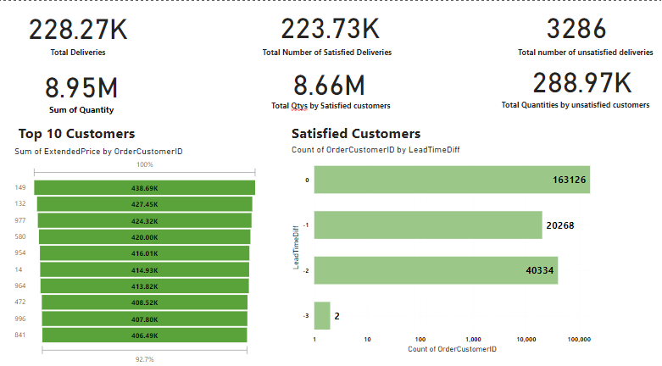
Supply Chain Dashboard for Store FIT Ltd
Visualisations:
Top 10 Customers (Sum of ExtendedPrice by OrderCustomerID):
This bar chart lists the top 10 customers based on the total value of their orders (ExtendedPrice). The top customer has spent 438.69K, and the 10th customer has spent 406.49K. This highlights the most valuable customers in terms of revenue.
Satisfied Customers (Count of OrderCustomerID by delivery time):
This bar chart shows the count of orders by customers with different lead time differences. LeadTimeDiff is a measure of how actual lead times compare to expected lead times:
0 LeadTimeDiff: 163,126 orders had no difference in lead time, indicating timely deliveries.
-1 LeadTimeDiff: 20,268 orders had a lead time difference of -1 day, indicating early deliveries.
-2 LeadTimeDiff: 40,334 orders were delivered 2 days earlier than expected.
-3 LeadTimeDiff: Only 2 orders were delivered 3 days earlier than expected.
Insights:
The majority of the orders (163,126) were delivered on time, which indicates good performance in meeting delivery promises.
There is a significant number of orders (20,268 and 40,334) that were delivered earlier than expected by 1 or 2 days, which can enhance customer satisfaction.
A small number of orders (2) were delivered significantly earlier (3 days), which is quite rare.
Conclusion:
This dashboard provides a comprehensive overview of order quantities, customer value, and delivery performance. The key takeaway is that most orders are being delivered on time or earlier than expected, which is likely to positively impact customer satisfaction and retention. Additionally, the top 10 customers contribute significantly to the revenue, emphasizing the importance of maintaining good relationships with these high-value customers.
a

Slide 14
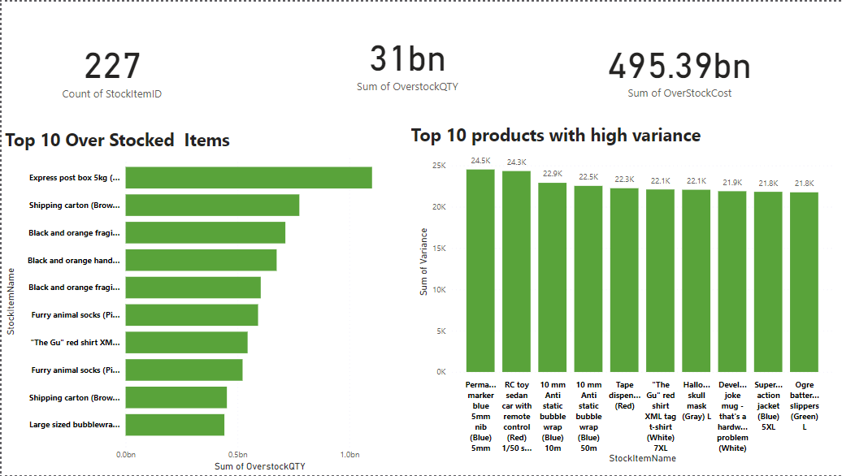
Supply Chain Dashboard for Store FIT Ltd
Key Metrics:
227 Count of StockItemID:
There are 227 unique stock items being considered in this analysis.
31bn Sum of OverstockQTY:
The total quantity of overstocked items sums up to 31 billion units.
495.39bn Sum of OverStockCost:
The total cost associated with overstocking these items is 495.39 billion units of currency.
Visualizations:
Top 10 Over Stocked Items (Sum of OverstockQTY):
This bar chart shows the top 10 items that have the highest quantities of overstock. The item names are partially visible, but here are some key observations:
Express post box 5kg has the highest overstock quantity, significantly higher than the other items.
Items like Shipping carton (Brown) and Black and orange fragile tape also have high overstock quantities.
The overstock quantities range from around 0.5 billion to just over 1 billion units.
Top 10 Products with High Variance (Sum of Variance):
This bar chart shows the top 10 products with the highest variance in stock levels. Variance here likely refers to the inconsistency in stock levels, indicating fluctuating inventory quantities.
Perma-marker blue 5mm nib (Blue) and RC toy sedan car with remote control (Red) have the highest variance, both around 24.5K units.
Other items with high variance include various types of anti-static bubble wrap, tape dispenser, red shirts, Halloween masks, and more.
The variances range from around 21.8K to 24.5K units.
Insights:
Overstocked Items:
The top 10 overstocked items represent a significant portion of the total overstock quantity. The Express post box 5kg, in particular, stands out with the highest overstock quantity.
Managing and reducing the inventory of these overstocked items can potentially reduce the associated costs (495.39bn).
High Variance Products:
The products with the highest variance indicate items with inconsistent inventory levels. These fluctuations could be due to irregular demand, supply chain issues, or inaccurate inventory management.
Addressing the causes of high variance can help in achieving more stable inventory levels and better stock management.
Conclusion:
The dashboard highlights critical areas for inventory management improvement. The significant overstock of certain items and high variance in others suggest a need for more precise demand forecasting and inventory control strategies. By focusing on reducing overstock quantities and managing items with high variance more effectively, the company can optimize inventory levels, reduce costs, and improve overall supply chain efficiency.

Slide 15
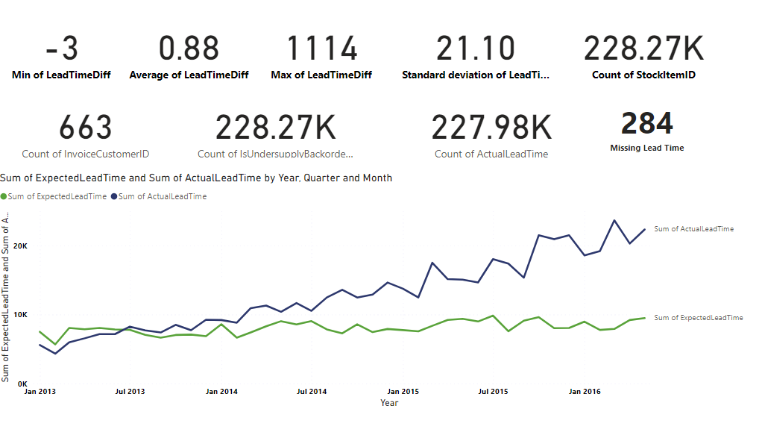
Supply Chain Dashboard for Store FIT Ltd
Visualisation:
Sum of ExpectedLeadTime and Sum of ActualLeadTime by Year, Quarter, and Month:
This line chart compares the sum of expected lead times versus actual lead times over time (from January 2013 to mid-2016).
Sum of ActualLeadTime: Represented by the blue line, showing fluctuations and an overall increasing trend over time.
Sum of ExpectedLeadTime: Represented by the green line, which is more stable and consistently lower than the actual lead time.
Insights:
Lead Time Differences:
The majority of lead times are close to expected, with an average lead time difference of 0.88 days. This suggests good performance in meeting delivery times.
The minimum and maximum delivery time differences (-3 to 1114) indicate there are some significant outliers which might need to be addressed separately.
Variability in Lead Times:
The standard deviation of 21.10 days shows high variability, suggesting inconsistent lead times across different orders.
Trends Over Time:
The line chart shows that actual lead times have been increasing over time, diverging more from the expected lead times. This could indicate growing inefficiencies or increased delays in delivery over the years.
The expected lead times have remained relatively stable, implying that expectations are not changing, but actual performance is deviating.
Missing Data:
With 284 missing lead time entries,
Conclusion:
The dashboard highlights that while most orders are delivered close to the expected time, there is significant variability and some extreme delays that need attention. The increasing trend in actual lead times compared to expected lead times suggests a need for process improvements to reduce delays and better meet customer expectations. Addressing data quality issues and analyzing the causes of outliers will be crucial for improving overall performance.
Notes:
Key Metrics:
-3 Min of LeadTimeDiff:
The smallest lead time difference recorded is -3 days, meaning some orders were delivered 3 days earlier than expected.
0.88 Average of LeadTimeDiff:
On average, the lead time difference is 0.88 days, indicating that orders are generally delivered slightly earlier than expected.
1114 Max of LeadTimeDiff:
The largest lead time difference recorded is 1114 days, which could indicate outliers or significant delays.
21.10 Standard Deviation of LeadTimeDiff:
The standard deviation of 21.10 indicates a wide variability in lead times.
228.27K Count of StockItemID:
The total number of stock items considered in the analysis.
663 Count of InvoiceCustomerID:
The number of unique customers (based on invoices).
228.27K Count of IsUndersupplyBackorder:
This likely represents the number of instances or orders flagged as undersupply or backorders.
227.98K Count of ActualLeadTime:
The total count of actual lead times recorded.
284 Missing Lead Time:
There are 284 instances where lead time data is missing.

Slide 16
Predictive Analytics for Store FIT Ltd
Task
Predicting the future sales quantities for different product categories.
Calculating the Safety Stock level and the Reorder point.
Action
Data Preparation: Imported necessary libraries and loaded the sales data into a pandas data frame. The data was parsed to ensure proper date-time handling.
Product Category Analysis
Isolated sales data for each product category.
Aggregated sales quantities on a monthly basis.
Applied a time series decomposition to understand trend and seasonality.
Split the data into training and testing sets.
Modelled sales using Exponential Smoothing and forecasted future quantities.
Evaluated the model's performance using mean squared error.

Slide 17
Product Categories of Store FIT Ltd
Packaging Materials
Novelty Items
Toys
Mugs
Computing Novelties
Clothing
T-Shirts
USB Novelties
Furry Footwear

Slide 18
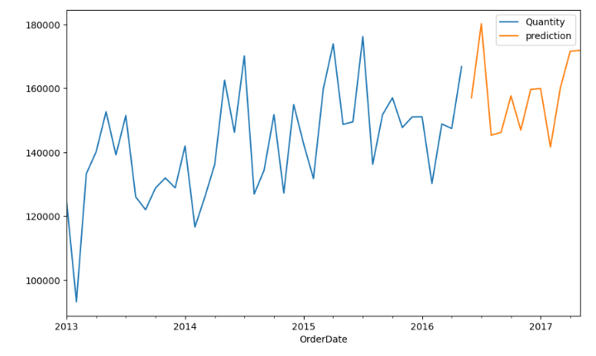
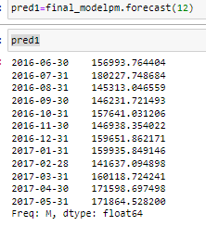
Prediction of Demand for the Next 12 months ( Packaging Materials)
Trend Analysis:
There is an overall increasing trend in demand from 2013 to 2016.
The fluctuations suggest that demand is influenced by factors that cause periodic increases and decreases, which could be seasonal effects, promotions, or market dynamics.
Notes:
There is seasonal variations, therefore plan inventory and safety stock accordingly to avoid overstocking or stockouts during peak and low demand periods.
There is an overall increasing trend in demand from 2013 to 2016.
The fluctuations suggest that demand is influenced by factors that cause periodic increases and decreases, which could be seasonal effects, promotions, or market dynamics.

Slide 19
Calculations for Safety Stock level, Reorder Point and Z-Score
Safety Stock Level: The safety stock level is the extra quantity of inventory held to mitigate the risk of stockouts caused by uncertainties in demand and supply. It acts as a buffer to ensure that there is enough stock to meet customer demand even if actual demand exceeds forecasts or if there are delays in supply. safety_stock_level = z_score * demand_std_dev * np.sqrt(lead_time)
Reorder Point: The reorder point is the inventory level at which a new order should be placed to replenish stock before it runs out. It is calculated to ensure that new stock arrives just in time to avoid stockouts, considering the lead time for replenishment.
reorder_point = lead_time_demand + safety_stock_level
Z- Score: The Z-score, also known as the standard score, is a statistical measure that indicates how many standard deviations a data point is from the mean of the dataset. It is used to standardize data and compare individual data points to the overall distribution.
z_scores = (data - mean) / std_dev

Slide 20
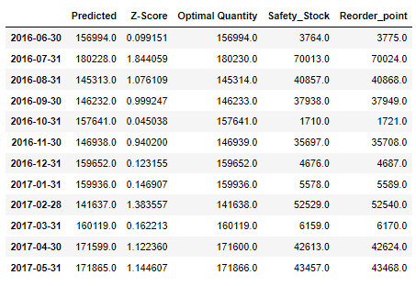
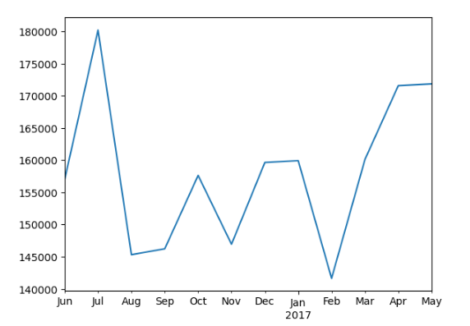
Analysis of Predicted Value, Optimal Value and Safety Stock Reorder points for Packaging Materials
Key Observations:
Demand Trends:
Peaks in July 2016 (180,230 units) and May 2017 (171,866 units).
Lower in February 2017 (141,638 units).
Service Levels:
Higher Z-Scores (e.g., 1.844 in July 2016) indicate higher safety stock needs.
Lower Z-Scores (e.g., 0.045 in October 2016) imply lower safety stock.
Safety Stock:
Correlates with Z-Score and demand.
High in July 2016 (70,013 units), low in October 2016 (1,710 units).
Reorder Points
Combine safety stock and demand.
High in July 2016 (70,024), low in October 2016 (1,721).

Slide 21
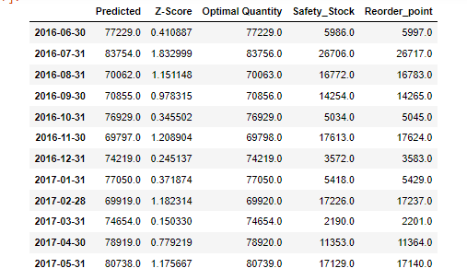
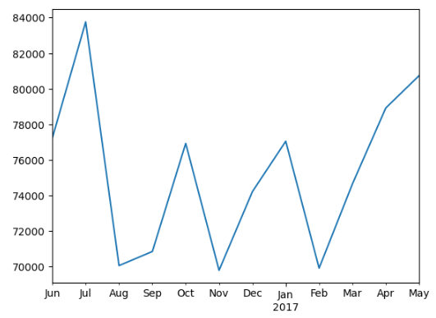
Analysis of Predicted Value, Optimal Value and Safety Stock Reorder points for Clothing
Key Observations:
Demand fluctuates monthly, with peaks in July 2016 and May 2017 and troughs in August 2016 and February 2017, reflecting seasonal patterns.
Safety stock adjusts based on demand variability (Z-Score) to maintain service levels, with higher Z-Scores requiring higher safety stocks.
Safety stock levels vary according to demand uncertainty, with higher Z-Scores indicating higher safety stocks.
Reorder points are set slightly above safety stock levels to ensure timely replenishment and supply continuity.
Effective management of safety stock and reorder points optimizes service levels while minimizing stockout risks.

Slide 22
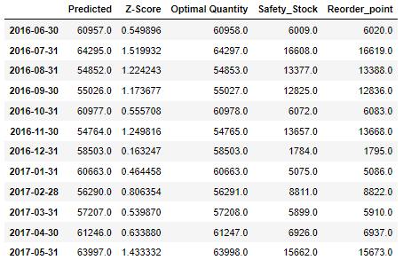
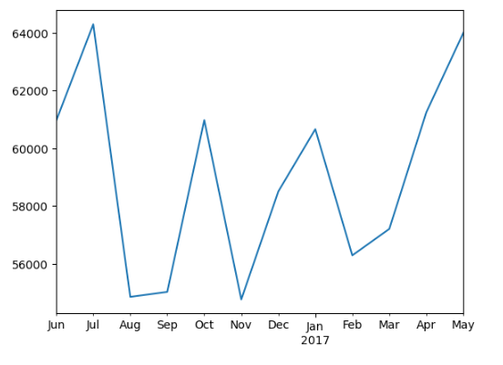
Analysis of Predicted Value, Optimal Value and
Safety Stock Reorder points for Computing Novelties
Key Observations:
Demand Trends:
Predicted demand shows seasonality, peaking in July 2016 (64295 units) and May 2017 (63997 units).
Service Levels:
Higher Z-Scores correspond with increased safety stocks and reorder points to maintain service levels during high demand variability.
Safety Stock:
Varies with Z-Score, significantly higher during months like July 2016 (16608 units) and May 2017 (15662 units).
Reorder Points:
Slightly above safety stock to ensure timely reordering, e.g., July 2016's reorder point is 16619 units.
The system dynamically adjusts inventory levels based on demand variability to ensure optimal service levels.

Slide 23
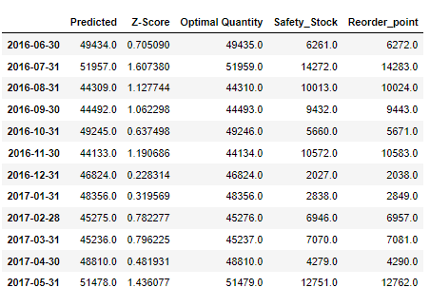
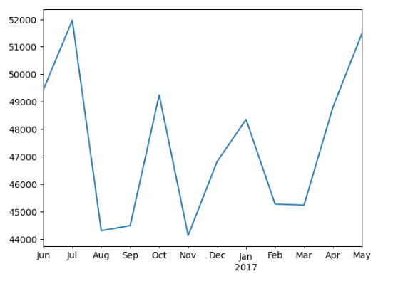
Analysis of Predicted Value, Optimal Value and Safety Stock Reorder points for T-Shirts
Key Observations:
Z-Score and Safety Stock:
High Z-Scores: Lead to higher safety stocks (e.g., July 2016, Z-Score 1.607380, Safety Stock 14272 units).
Low Z-Scores: Result in lower safety stocks (e.g., December 2016, Z-Score 0.228314, Safety Stock 2027 units).
Reorder Point Calculation:
Reorder points are consistently about 11 units above safety stock to ensure timely reordering.
Seasonal Demand Trends:
Demand peaks in July 2016 and May 2017; dips in August 2016 and February 2017.
Optimal Quantity Alignment:
Optimal quantities match predicted demand exactly.
Efficient Inventory Management:
Dynamic adjustments based on Z-Score balance inventory costs and stockout risks.

Slide 24
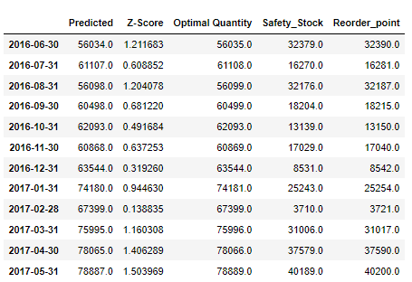
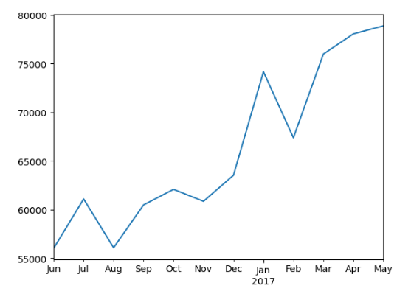
Analysis of Predicted Value, Optimal Value and Safety Stock Reorder points for Novelty Items
Key Observations:
Demand fluctuates monthly, with peaks in Jan 2017 and May 2017 and troughs in August 2016 and February 2017, reflecting seasonal patterns.
Safety Stock: Safety stock levels vary significantly, with higher values observed during periods of higher demand variability, indicated by higher Z-Scores.
For instance, in March 2017, with a Z-Score of 1.160308, the safety stock is 31006 units, whereas in February 2017, with a Z-Score of 0.138835, the safety stock decreases substantially to 3710 units.
By aligning safety stock and reorder points with demand variability, the business can optimize inventory management practices, maintaining service levels while minimizing excess inventory holding costs.

Slide 25
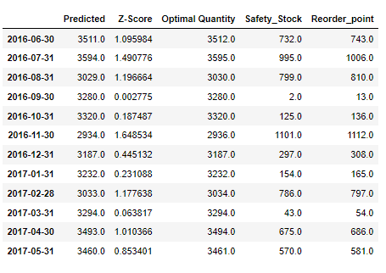
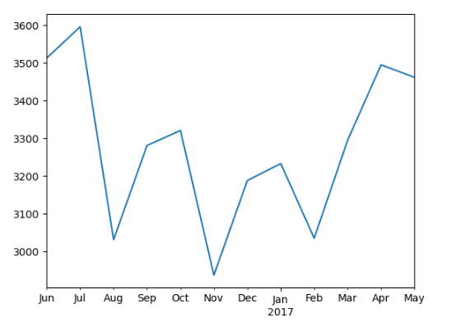
Analysis of Predicted Value, Optimal Value and Safety Stock Reorder points for Toys
Key Observations:
Demand fluctuates monthly, with peaks in July 2016, Oct 2016 and April 2017 and dips in August 2016, November 2016 and February 2017, reflecting seasonal patterns.
Safety stock and reorder points increase with higher Z-Scores, reflecting greater demand variability.
High Z-Score Periods:
Example: July 2016 (Z-Score: 1.490776), safety stock: 995 units, reorder point: 1006 units.
Implication: Increased safety stock and reorder points to buffer against high demand variability.
Low Z-Score Periods:
Example: September 2016 (Z-Score: 0.002775), safety stock: 2 units, reorder point: 13 units.
Implication: Minimal safety stock due to low demand variability.
Consistent Increment:
Reorder points are generally about 11 units higher than safety stock, ensuring timely reordering.

Slide 26
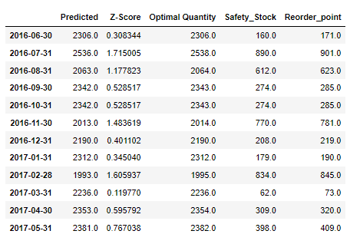
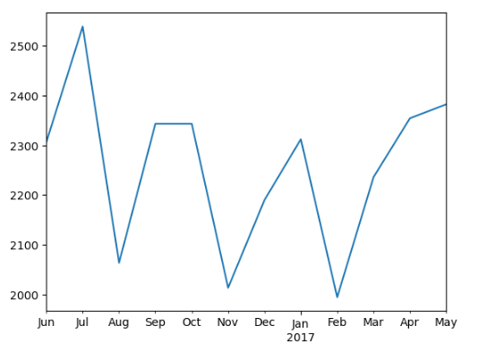
Analysis of Predicted Value, Optimal Value and Safety Stock Reorder points for USB Novelties
Key Observations:
Demand fluctuates, with peaks in July 2016 and May 2017 and reduces in August 2016, November 2016 and February 2017, reflecting seasonal patterns.
Safety stock and reorder points increase significantly with higher Z-Scores, indicating the system's adjustment to demand variability.
High Z-Score Periods:
Months with higher Z-Scores, like July 2016 (1.715005), correspond to substantially higher safety stock levels and reorder points.
Low Z-Score Periods:
Conversely, lower Z-Scores, such as March 2017 (0.119770), result in lower safety stock levels and reorder points.
Consistent Reorder Strategy:
Reorder points consistently maintain a small buffer above safety stock, ensuring timely replenishment.

Slide 27
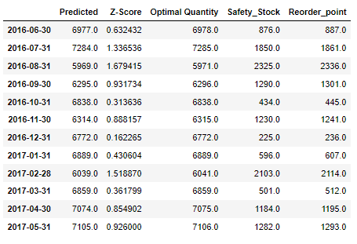
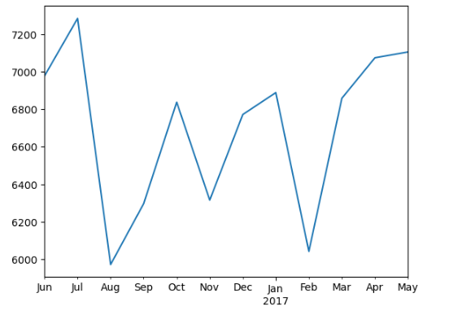
Analysis of Predicted Value, Optimal Value and Safety Stock Reorder points for Mugs
Key Observations:
Demand is high in July 2016 and May 2017 and low in August 2016 and February 2017, reflecting seasonal patterns.
Safety stock and reorder points increase with higher Z-Scores, reflecting greater demand variability.
High Z-Score Periods:
July 2016: Z-Score 1.34, Safety Stock 1850, Reorder Point 1861
August 2016: Z-Score 1.68, Safety Stock 2325, Reorder Point 2336
February 2017: Z-Score 1.52, Safety Stock 2103, Reorder Point 2114
Low Z-Score Periods:
December 2016: Z-Score 0.16, Safety Stock 225, Reorder Point 236
October 2016: Z-Score 0.31, Safety Stock 434, Reorder Point 445
Consistent Buffer:
Reorder points are consistently about 11 units above safety stock.

Slide 28
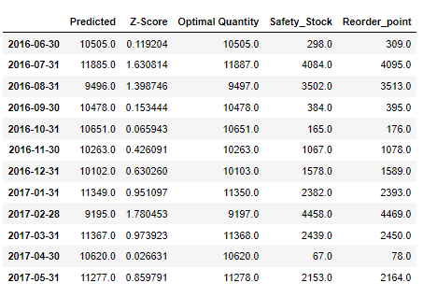
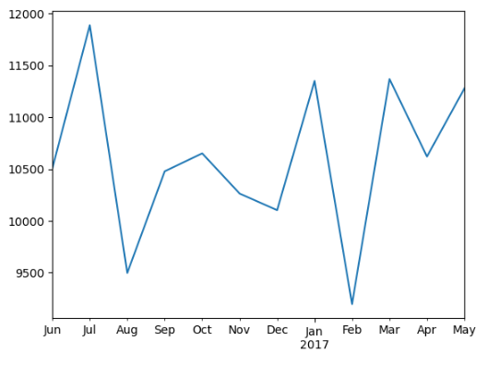
Analysis of Predicted Value, Optimal Value and Safety Stock Reorder points for Furry Footwear
Key Observations:
Demand Trends:
Fluctuating predicted quantities suggest varying demand patterns, possibly influenced by seasonal trends. Notable peaks and troughs can be observed across months from June 2016 to May 2017.
Service Levels:
Higher Z-Scores, such as 1.630814 in July 2016 and 1.780453 in February 2017, indicate better service levels, reflecting the company's ability to meet demand variability.
Safety Stock:
Safety stock quantities vary across months, with figures ranging from 67 in April 2017 to 4458 in February 2017, reflecting changing risk profiles associated with demand variability.
Reorder Points:
Reorder points, ranging from 78 in April 2017 to 4469 in February 2017, are influenced by demand variability and lead time, with higher values needed to prevent stockouts.

Slide 29
Findings
Overstocking of 225 out of 227 Products
Longer Lead Times
Inadequate ERP System Integration
Lack of Real-Time Data Visibility
Low Backorder Rate affecting only 9 Products
Limited Product Demand Forecasting
Data Quality Issues – Missing Lead Time Entries
Inaccurate Inventory Management

Slide 30
Recommendations
Overstocking
Adjust safety stock levels to the accurate demand forecasted for each products.
Inaccurate Inventory Management
Implement automated inventory management to streamline order processing.
Longer Lead Times
Enhance supplier collaboration to improve lead times and ensure faster replenishment of stocks.
Lack of Real Time Visibility
Apply the real time supply chain dashboard for enhanced visibility and better decision making.
Inadequate ERP System Integration
Implement an ERP system that integrates all aspects of supply chain management.
Limited Product Demand Forecasting
Apply the predictive analytics to improve the accuracy of demand forecasts and ensure continuous forecast validation.
Data Quality Issues
Implement data cleansing and validation processes to ensure the accuracy and completeness of lead time entries and inventory records.
Low Backorder Rate
Optimise backorder management by ensuring sufficient stock levels of high-demand items to prevent stockouts.
Customer Satisfaction
Enhance customer satisfaction by improving communication with customers regarding order status and expected delivery times.
Data Quality Issues
Establish a data governance framework to maintain data quality standards, including regular audits and updates to ensure data integrity.
Continuous Improvement
Establish a process for continuous monitoring and improvement, ensuring that inventory management practices remain aligned with business objectives and market conditions.
Notes:
Overstocking: For the current overstocked 225 products, implementing inventory optimization techniques such as Just-In-Time (JIT) inventory management can reduce the excess stock and associated holding costs. Furthermore, adjusting the safety stock levels to the predicted demand forecasted will reduce future overstocking situations.
Inaccurate Inventory Management: Maintaining an appropriate level of safety stock to buffer against unexpected demand surge. Adopting the precise reorder points for inventory replenishment, and prioritising high-demand items with more frequent restocking and monitoring.
Longer Lead Times: Appropriate supplier management would resolve the situation. Choosing suppliers with a track record of timely deliveries and having multiple suppliers for critical items to reduce the risk of delays.
Lack of Real Time Visibility: Adopting the supply chain dashboard and ensuring that the ERP system, key metrics and inventory management systems are integrated for better monitoring and decision making. Also, integrating RFID technologies for real-time tracking of inventory and shipments to enhance visibility and accuracy across the supply chain.
Inadequate ERP System Integration: Implementing a comprehensive ERP system that integrates all aspects of supply chain management, including Purchase Orders, Manufacturing Orders, Sales Orders, and CRM will provide a unified platform for better coordination and efficiency.
Limited Product Demand Forecasting: Adopting the predictive analytics, and other advanced forecasting tools and integrating them with the inventory management system.
Data Quality Issues: Continuous data cleansing and validation would resolve this challenge, as well as, establishing a data governance framework to maintain high data quality.
Low Backorder Rate: Using automated systems for inventory replenishment based on real-time data such as adopting the predictive analytics that determines the product demands, safety stock levels and sets the reorder points, would eliminate the issues of unjust backorders.
Customer Satisfaction: Can be improved by proactive communication. Keeping customers informed about order status, potential delays or expected delivery times. As well as allowing customers to place pre-orders to manage expectations and product demand better.
Continuous Improvement: Conducting regular audits of the supply chain processes to identify and address inefficiencies. Also, establishing feedback loops with sales and customer service teams to continually improve demand forecasting and inventory management practice.

Slide 31
solutions
Solutions to the 225 Overstocked Products
Assessment and Segmentation
Conducting an assessment to identify the specific 225 products that are overstocked and segmenting them based on factors such as demand, shelf life, and potential for quick sale.
Inventory Management Optimization
Implementing Just-In-Time inventory practices to minimize holding costs by fulfilling customer orders with the current stock of products.
Immediate Disposal Strategies
Organising sales and promotions with significant discounts to attract customers. Promoting the sales through all available channels, including the company website, social media, online marketplace and email marketing.
Safety Stock Optimisation
Reevaluating safety stock levels based on the variability of demand and lead times.
Notes:
To dispose of excess inventory for the 225 products immediately, StoreFIT can employ these methods to clear out the excess stock quickly while minimizing financial losses and potentially even generating some revenue. In addition, they can establish partnerships with other businesses that might find the products useful and offer them at a discounted bulk rate or dedicate a section of the retail outlets specifically for clearance items. Clearly mark down prices and promote the clearance section.

Slide 32
solutions
Solutions to the 9 Products causing Backorder
Expedite Existing Orders
Contacting and negotiating with suppliers to expedite the shipment of these 9 products. Paying for express shipping if necessary to receive the stock faster.
Production Acceleration
Increasing production by prioritising the production of these items, manufacturing the products in-house or through contract manufacturers. Allocating more resources to speed up the production process.
Reallocate Existing Inventory
Checking inventory levels across all 25 retail outlets. Reallocating stock from stores with surplus inventory to those with backorders.
Customer Communication
Sending out notifications to customers with backorders, providing updates and possible compensation for delays.
Safety Stock Optimization
Adjusting safety stock levels and reordering policies for the 9 products based on real-time data and predicted demand.
Notes:
To resolve the backorder problem for the 9 specific products immediately, it is essential to take these swift and strategic actions. Alternatively, suggesting alternative products that can fulfil the same need, ensuring that these substitutes are in stock and offered at a comparable price. Run promotions on substitute products to encourage customers to purchase these items instead.
Supplier Performance Monitoring: Regular Check-ins:
Maintain regular communication with suppliers to monitor their performance and address any potential delays proactively.

Slide 33
Conclusion
The supply chain optimization project for StoreFIT Limited has revealed critical insights into the company's operational challenges and opportunities for improvement. Through a detailed analysis of overstocked product lines, longer lead times, inadequate ERP system integration, lack of real-time visibility, low backorder rates, inaccurate demand forecasting, and data quality issues, we have identified several actionable recommendations.
Implementing advanced predictive analytics, enhancing ERP system integration, improving real-time visibility, and optimizing inventory management practices will address these inefficiencies and align StoreFIT's operations with its goal of maximizing customer satisfaction.
By adopting these strategies, StoreFIT Limited is poised to reduce costs, enhance customer experience, and support its continued growth and success in the competitive retail market.
These recommendations align with StoreFIT’s overarching goal of maximizing customer satisfaction by ensuring product availability and timely delivery.
Notes:
We have identified the critical challenges and proffered solutions tailored to the challenges. By adopting these strategies, we believe that Store FIT can expect reduced costs, operational efficiency, enhanced customer experience and scalability.
Moving forward, StoreFIT Limited should focus on:
Pilot Testing: Implementing changes on a pilot basis to measure impact.
Performance Monitoring: Establishing KPIs to monitor the effectiveness of implemented strategies.
Continuous Improvement: Regularly updating practices based on performance data and market conditions.

Slide 34

Thank You

